Slide 2

“Quizander”- A Text-based Multiplayer Game
Project Title

Slide 3

Submitted By:
Name | Course | Roll No. | SAP Id
Aditya Sharma | BFSI | R133218002 | 500069141
Rishav Singh | BFSI | R133218035 | 500071526
Ritul Priya | BFSI | R133218020 | 500069262
Under the guidance of:-
Mr. Alind
Assistant Professor(Senior Scale),SOCS
Department Of Virtualization
SCHOOL OF COMPUTER SCIENCE
UNIVERSITY OF PETROLEUM AND ENERGY STUDIES
Bidholi Campus, Energy Acres,Dehradun-248007

Slide 4
Index
Serial No. | Contents | Slide No.
1. | Abstract | 5
2. | Introduction | 6-8
3. | Problem Statement | 9
4. | Objectives | 10
5. | Methodology | 11-12
6. | Concept Used | 13
7. | Algorithms | 14-16
8. | Implementation | 17-25
9. | Challenges Faced | 26
10. | Plan of Work | 27
11. | System Requirements | 28
12. | Outcome | 29
13. | References | 30

Slide 5

Abstract
Building a text based game of both single player and multiplayer mode in a time limited frame.
There will be five exciting categories and each category will contain three rounds.
Moving to the succeeding round requires the fulfilment of certain criteria's.
A point will be credited on giving the right answer within the limited time frame.
This is basically a fun-loving game which enhances the cognitive skills and allows you to expand your intelligence and problem-solving skills.
Highest scorer will be entitled by “QUIZIHILIC”.

Slide 6
Introduction
Quizander is a text-based game designed in C language which can be played in both single player and multiplayer mode.
Each category will have three rounds and every round will have different criteria’s to pass the respective round.
With each successive round, the number of questions will rise along with the difficulty level. Time duration decreases as moving to next level.
There will be two hints provided to the user in each round.
The sequence of the questions will be change every time the player starts the game.
Scores are stored in files which will help us in order to display the player name who is liable to gain the entitlement of QUIZIHILIC.

Slide 7

Categories Distribution
Categories
10 second Observer Challenge
Polling Round Fire
Match the following
Getting the ways out
Ultimate Fusion
Basic Round
Question: 7
Time Slot: 50sec
Intermediate Round
Questions: 10
Time Slot: 40 sec
Final Round
Question: 12
Time Slot: 30 sec

Slide 8

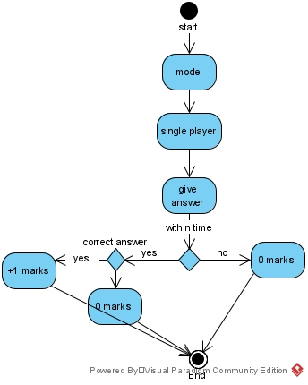
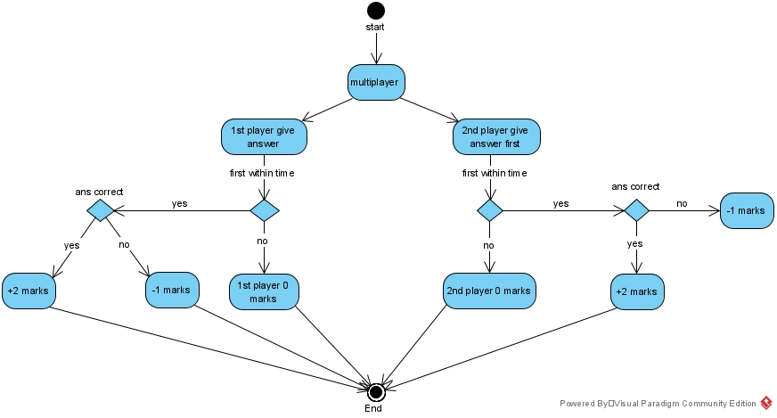
Marking scheme
SINGLE-PLAYER
MULTI-PLAYER

Slide 9

Problem Statement
As most text-based games are in single player mode and players miss the exciting catches. So we are building a text based multiplayer game in a limited time frame, where the questions will be like a ride and will make the user’s mind blend.

Slide 10


Objectives
Creating an Text Based Multiplayer on a Single Window.
=> Creating an interface for the users to play Single & Multiplayer
. mode.
=> Taking user Input on the parallel running of timer loop using Kbhit Function.
=> Implementing the Algorithms Under Different Rounds.
=> Integration of all the Categories with specific Rounds in Both the Mode

Slide 11

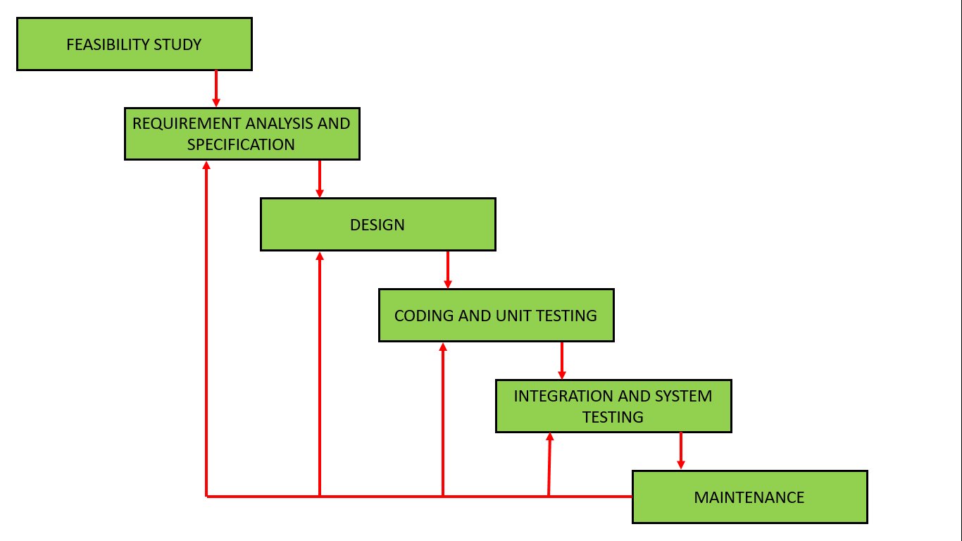
Methodology
We are using the iterative waterfall model for our project.
Fig1 Feedback paths introduced by the iterative waterfall model are shown in the figure. ¹
¹ Source - The above picture shows the stages of iterative waterfall model retrieved from - https://www.geeksforgeeks.org/

Slide 12
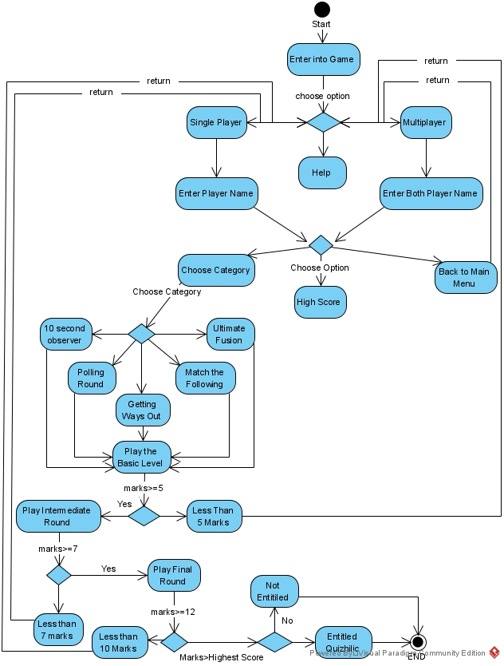
Functioning Of Game

Slide 13
Concepts Used
Header Files:
Windows.h
String.h
Functions:
Rand() - Random number generator
Kbhit() - when a key is pressed it returns nonzero value, otherwise returns zero.
Sleep()- It makes the program wait for a short interval.
System(“cls”) - It clears the output screen of the program.
Strupr() - The strupr( ) function is used to convert a given string to uppercase.
File Handling

Slide 14
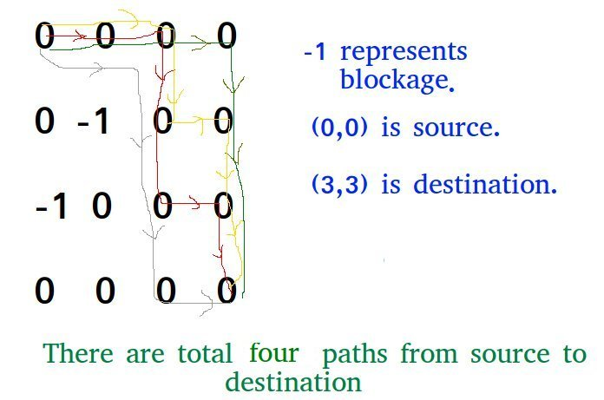
Algorithms
1. Count the number of ways to reach destination in a Maze Algorithm
i
0 0 0 0
0 -1 0 0
-1 0 0 0
0 0 0 0
j
Matrix A=
Given a maze with obstacles, count number of paths to reach rightmost-bottommost cell from topmost-leftmost cell. A cell in given maze has value -1 if it is a blockage or dead end, else 0.
The idea is to modify the given grid[][] so that grid[i][j] contains count of paths to reach (i, j) from (0, 0) if (i, j) is not a blockage, else grid[i][j] remains -1.
Input
Fig 1 Matrix or maze
Output:-
Total possible ways:-4
Fig 1.1 A matrix in counting the number pf ways to reach the destination. ¹
¹ Source:- Retrieved from geeksforgeeks retrieved from - https://www.geeksforgeeks.org/count-number-ways-reach-destination-maze/#:~:text=Given%20a%20maze%20with%20obstacles,
%2C%20j%2B1)%20only.

Slide 15
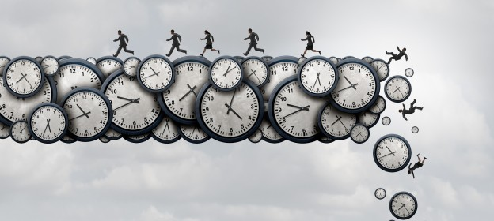
2. Marking under Time Algorithm
Marking under time Algorithm is a marking system based on the time interval scheduling algorithm.
This algorithm is applied for the marking system inside the game for various rounds .
This algorithm states that whoever answers correctly in less time slot then they would be given first priority.
Fig 1 It displays the time algorithm ¹
Input:-
P= p1 || time= 21 sec || ch=1
P= p2 || time= 18 sec || ch=1
Output:-
P1 = 0.5 marks
P2 = 1 marks
¹ Source:- The above picture is retrieved from – www.medium.com

Slide 16
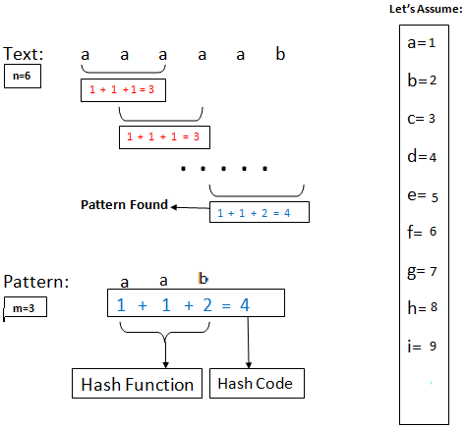
3. Rabin-Karp Algorithm for Pattern Searching:-
Input
Rabin-Karp algorithm also slides the pattern one by one. But unlike the Naive algorithm, Rabin Karp algorithm matches the hash value of the pattern with the hash value of current substring of text, and if the hash values match then only it starts matching individual characters. So Rabin Karp algorithm needs to calculate hash values for following strings.
1) Pattern itself. 2) All the substrings of text of length m.
Output
Fig 1 Rabin-Karp Algorithm ¹
¹ Source – The above picture describes the example of Rabin Karp retrieved from - https://www.geeksforgeeks.org/

Slide 17
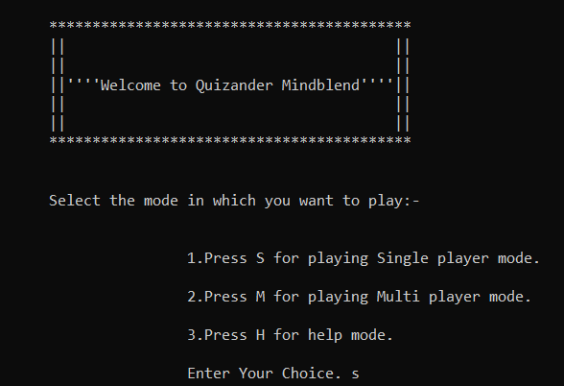
Pseudocode For Main Window Screen
Step 1: Import all the Header Files.
Step 2: Declare Main function.
printf(“Welcome Screen”)
Step 3: Display Choice for player.
S = Single Player
M= Multiplayer
H = Help
Step 4: Declare function for Single Player.
Declare function for Multiplayer.
Declare function for Help Mode.
printf(“Write Name”)
Declare Choices for Player Mode
{
1. Choose Category
2. Highest Score
3. Back to Main menu
}}
Stop}
Fig 1.1 Welcome Screen

Slide 18

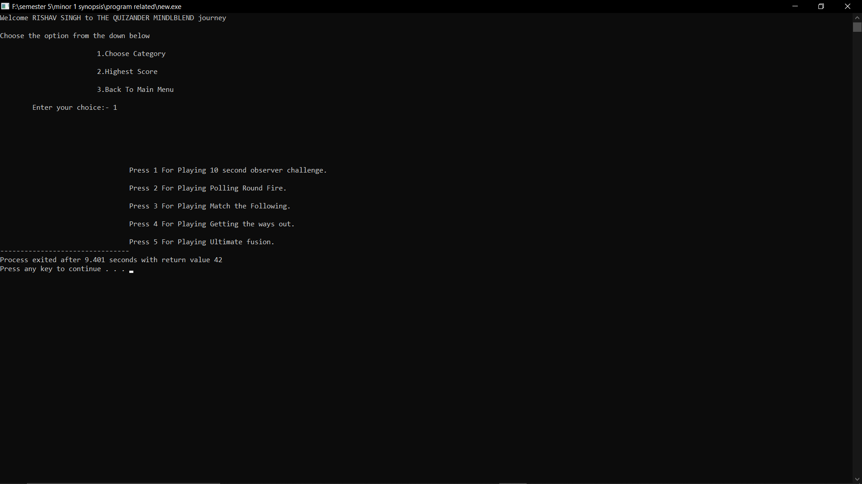
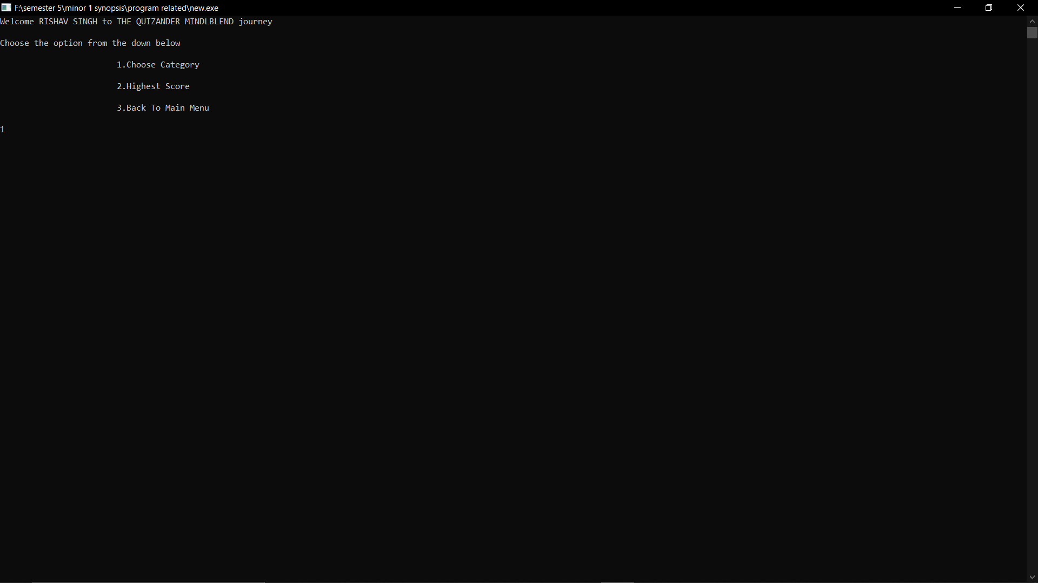
Output
Fig 1.2 Registering Player Name
Fig 1.3 Drop Down Menu
Fig 1.4 Choose Category

Slide 19
Pseudocode For 10 Second Observer
Step 1: Import all header files.
Step 2: Declare the object function by:
int object(*name);
Step 3: Declare main function
Step 4: Call the object function (object()) in the main:
print the welcome screen.
Step 5: Declare the random generator function.
int object(char* name)
{
srand(time(NULL));
for(i=0;i<=n-1;i++)//n is no of question.
{
temp=rand()%n;
for(j=0;j<=i-1;j++){
if(temp==a[j])
break;}
if(j==i)
a[i]=temp;
else
i--;}
Step 6: Declare variable for the object and display 30 objects name for 10 seconds.
Step 7: while(!kbhit() && TRUE)
{
printf(" \r 00:00:%2d",s);
ms++;
Sleep(10);
if(ms==11)
} system(“cls”);
Step 11 : Accepts the user input and check:
if(answer==right)
marks=marks+1
else
marks=marks+0;
Step 12: After the completion of each round:
if(total_marks>=required_score)
enter to next round;
else
back to main menu;
Step 8: Display questions
Step 9: Declare time function
Step 10: while(!kbhit() && TRUE)
{
printf(" \r 00:00:%2d",s);
ms++;
Sleep(10);
if(ms==31)
} system(“cls”);

Slide 20
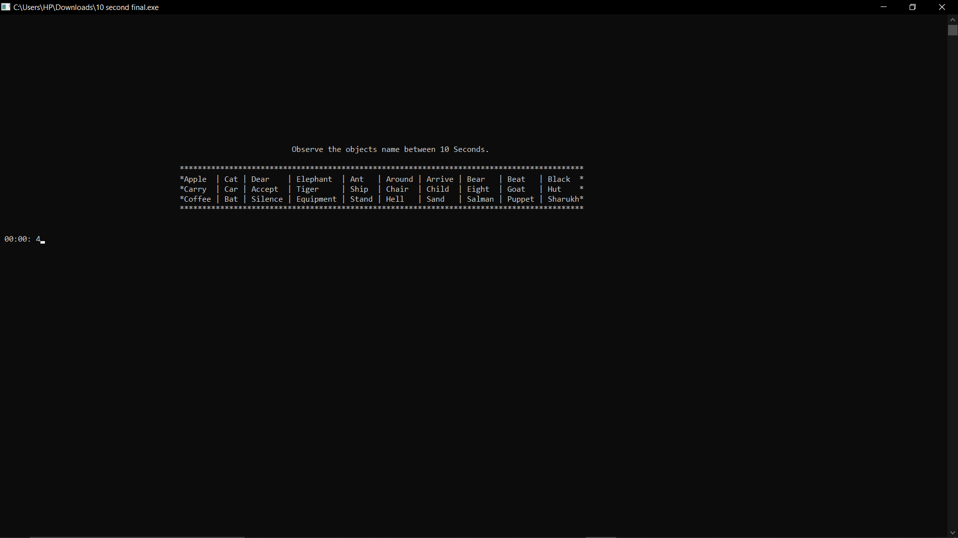
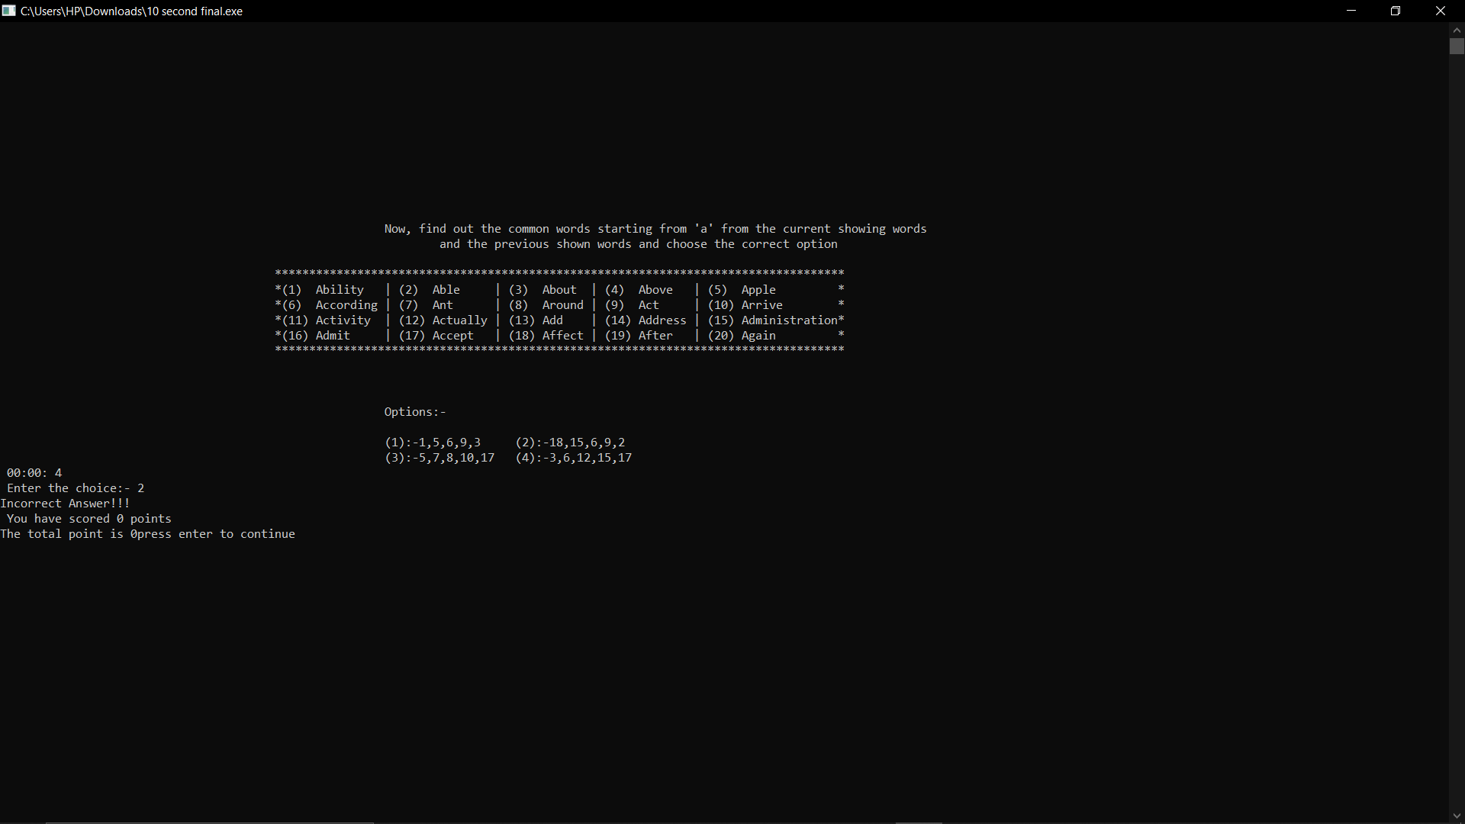
Output
Fig 1.1 Objects Displaying for 10 Seconds.
Fig 1.2 10 Second observer Question

Slide 21
Pseudocode For Match The Following And Polling Round And Ultimate Fusion
Step 1: Import all header files.
Step 2: Declare the match/poll function by:
int match(*name)/int poll(*name);
Step 3: Declare main function
Step 4: Call the match/poll function (object())/(poll()) in the main:
print the welcome screen.
Step 5: Declare the random generator function.
int match(char* name)/int poll(char*name)
{
srand(time(NULL));
for(i=0;i<=n-1;i++)
{
temp=rand()%n; // n= no of question.
for(j=0;j<=i-1;j++){
if(temp==a[j])
break;}
if(j==i)
a[i]=temp;
else
i--;}
Step 6: Declare variable for the polling/matching question and start the timer.
Step 7: Display questions
Step 10 : Accepts the user input and check:
if(answer==right)
marks=marks+1
else
marks=marks+0;
Step 11: After the completion of each round:
if(total_marks>=required_score)
enter to next round;
else
back to main menu;
Step 8: Declare time function //time limit will be according to the round
Step 9: while(!kbhit() && TRUE)
{
printf(" \r 00:00:%2d",s);
ms++;
Sleep(10);
if(ms==41)
} system(“cls”);

Slide 22
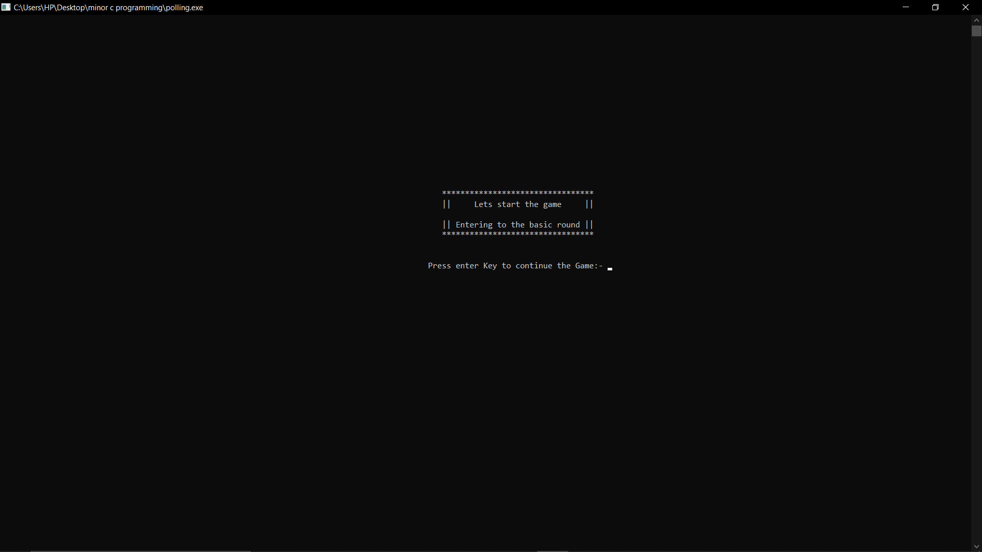
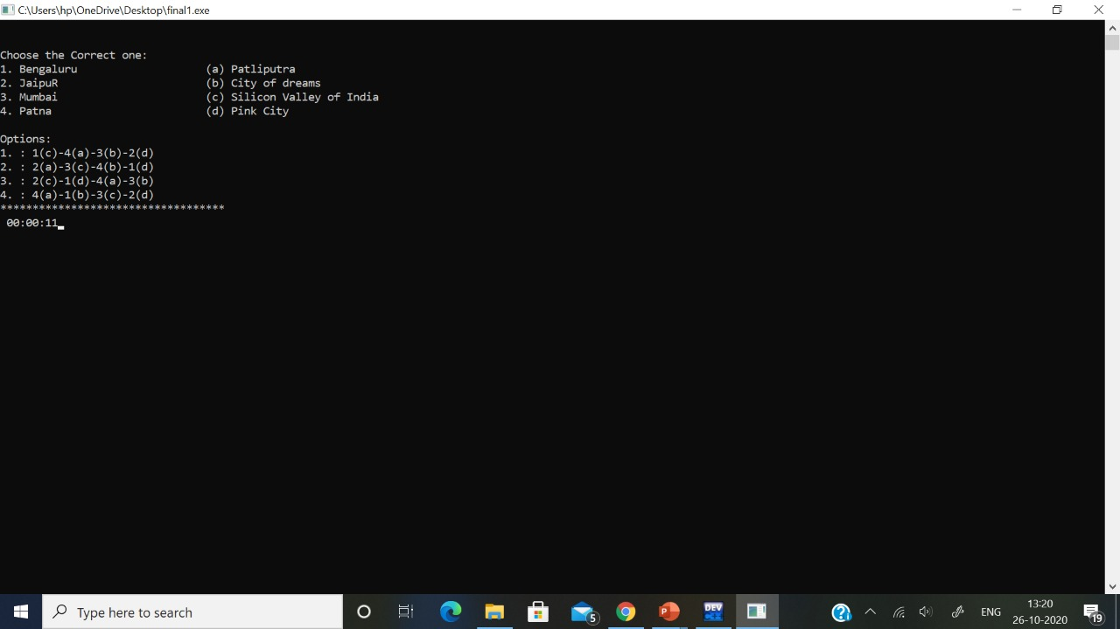
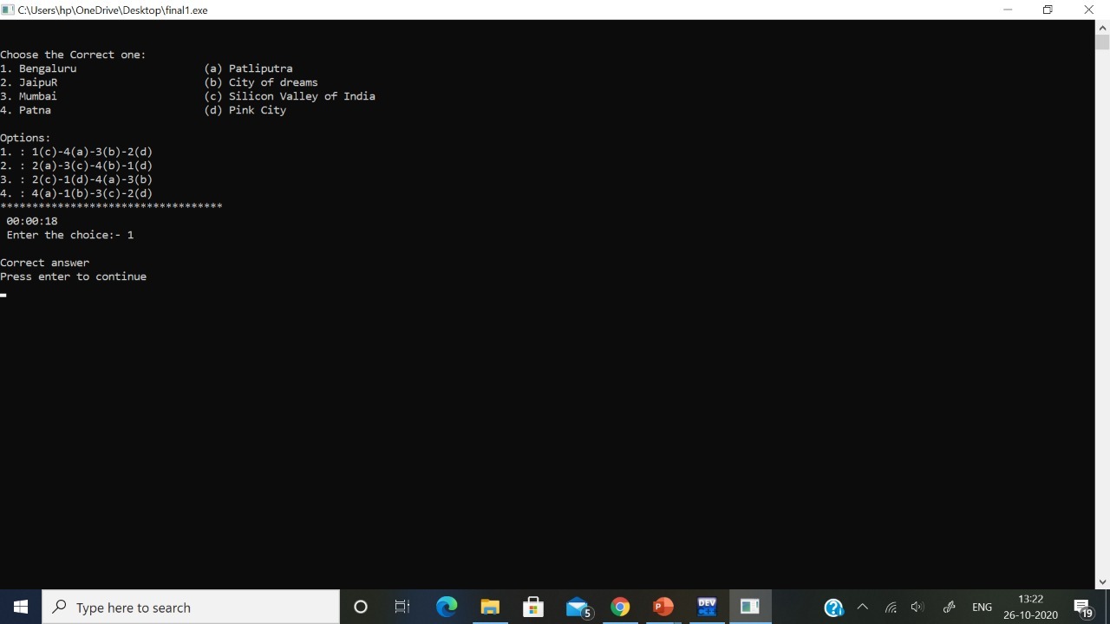
OUTPUT
Fig 1.1 Basic Round Welcome Screen
Fig 1.2 Match the following Question
Fig 1.3 Match the following with option

Slide 23
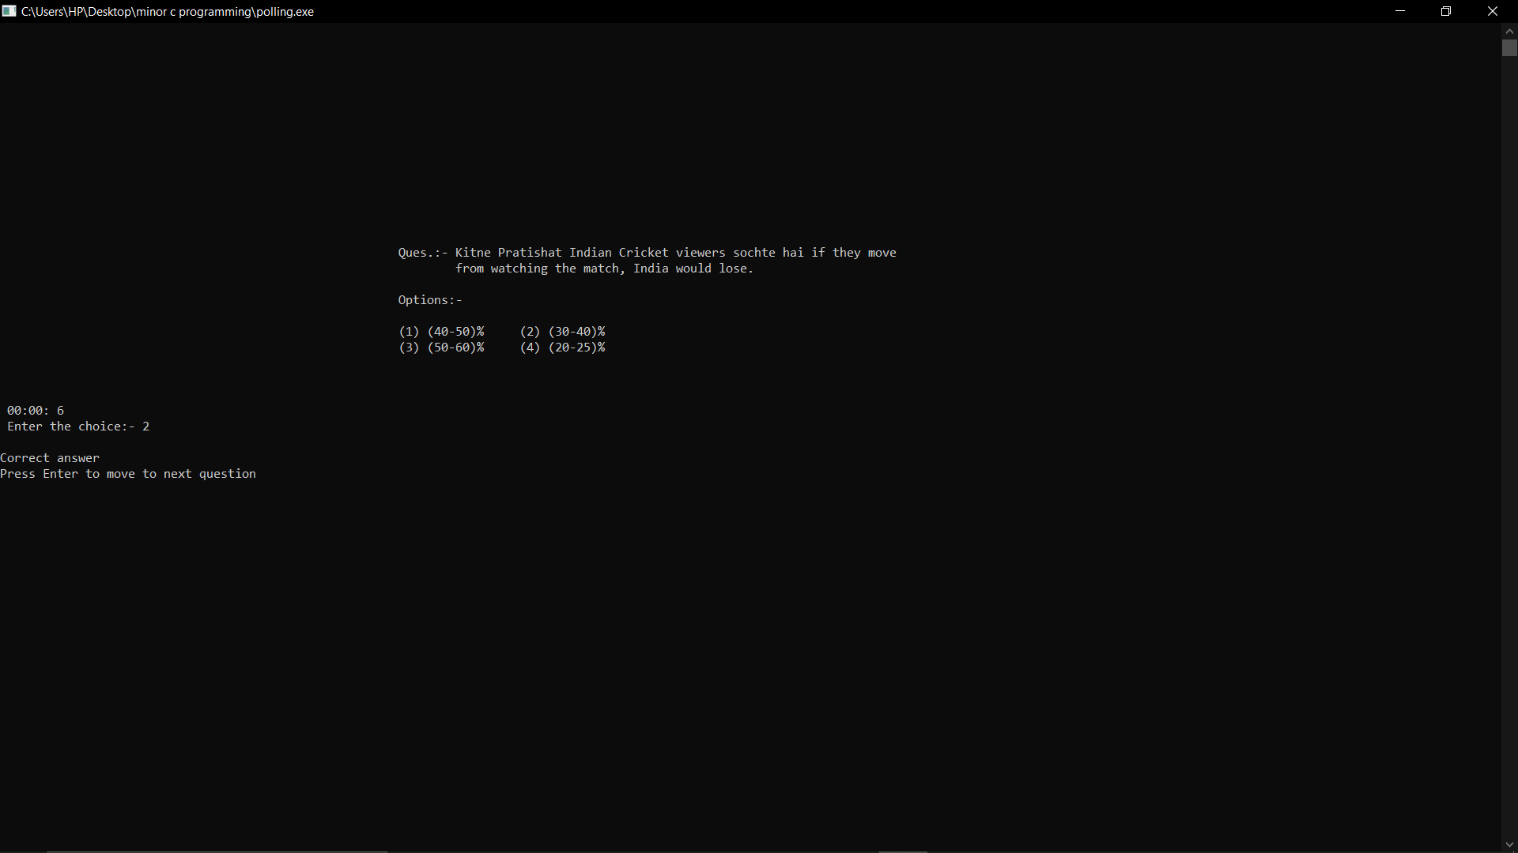
OUTPUT
Fig 1.4 Polling Round Fire with Option

Slide 24
Getting the Ways Out

Slide 25
OUTPUT

Slide 26
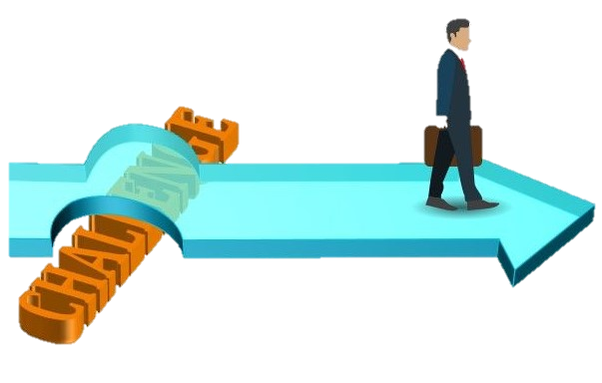
Challenges Faced
Collection of unique questions for the game database of different categories.
Implementation of timer for each question under different categories and inclusion of user input between the timer loop.
As the timer loop was running, the control wasn’t going to the user input until the timer end.
Using random generator for displaying the questions without repetition and assigning the range of the rand() function.
Integration of all the Categories with different rounds in Single & Multiplayer mode.

Slide 27

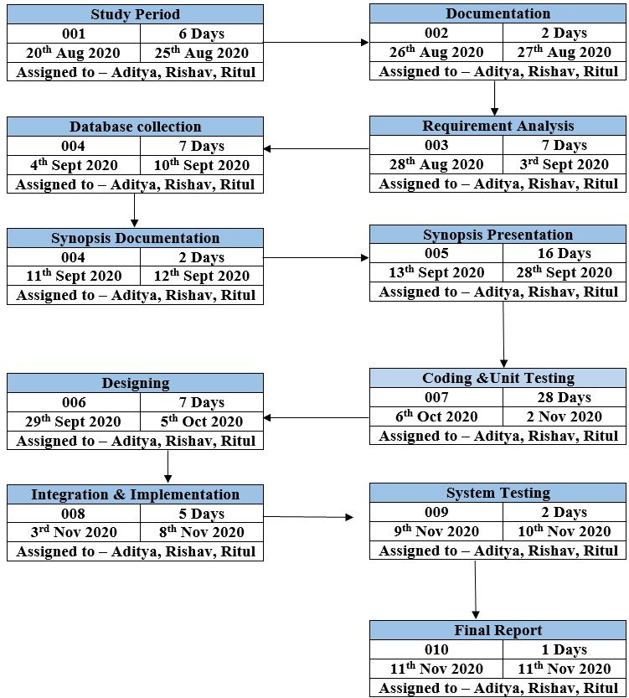
Plan of Work
Pert Chart:

Slide 28

System Requirements
Software Requirements
Name of Component | Specification
Operating System | Windows 10
Front End | C language
IDE Required | Dev C++
Hardware Requirements
Name of Component | Specification
Processor | Intel® Core™ i5-8250U CPU @ 1.60 GHZ 1.80 GH
RAM | 4 GB
Hard Disk | 1 TB

Slide 29
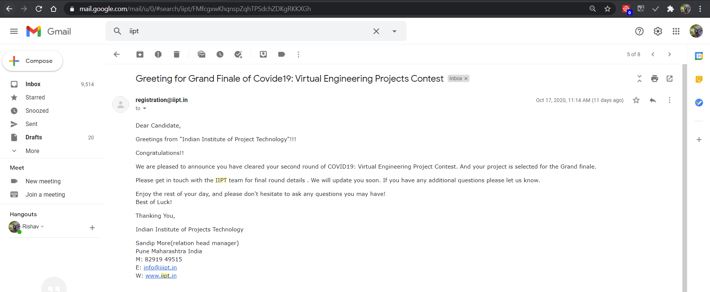
Outcome

Slide 30
References
[1] Lives, Avalon, The Legend. "Online RPG Game - Avalon - Text Based Games“ L.A – 2-12-2020 5:33 PM
[2] Manninen, T. (2001) Virtual team interactions in networked multimedia games. Case: ‘Counter-Strike’ – multi-player 3D action game. L.A – 23-11-2020 6:07 PM
[3] 5. Lee, K. M. & Nass, C. (2003) Designing social presence of social actors in human
computer interaction L.A – 30-11-2020 4:00 PM
[4] Everquest invokes dungeons and dragons spirit. Online article and video
Presentation Verified 31.08.03. L.A – 2-12-2020 6:00 PM
[5] Tromp, J., Steed, A. & Wilson, J. R. (2003). Systematic usability evaluation and design issues for collaborative virtual environments. Presence, 12:3, 241-267 L.A – 30-11-2020 4:30 PM
[6] https://pdfs.semanticscholar.org/7678/9b22b2862999b1a95cad0fc66d21e783012d.pdf L.A – 30-11-2020 4:50 PM
[7] https://www.geeksforgeeks.org/software-engineering-iterative-waterfall-model L.A – 4-12-2020 7:20 PM
[8] https://patents.google.com/patent/US20090221372A1/en L.A – 12-11-2020 5:30 PM
[9] https://techcrunch.com/2015/10/31/the-history-of-gaming-an-evolving-community/
L.A – 19-11-2020 8:00PM

Slide 31


